Slide 1
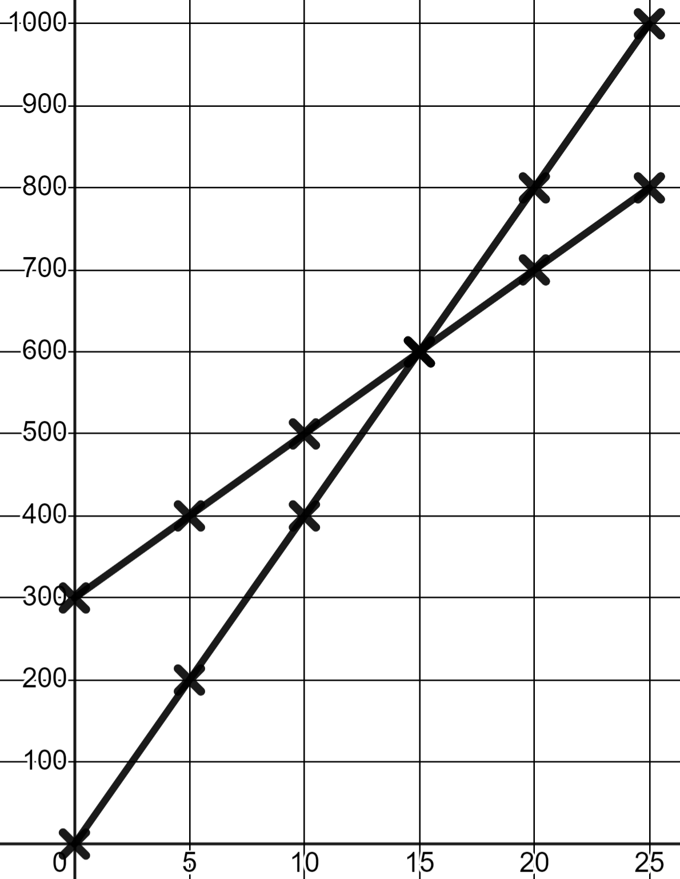
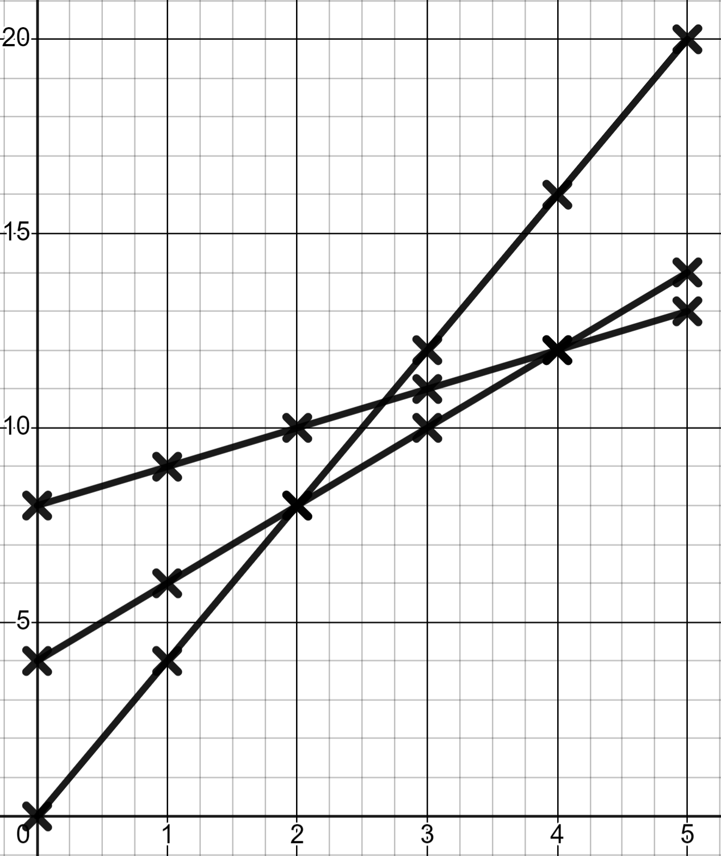
Problem solving with graphing linear relationships
Task A: Problems involving linear relationships
1) Andeep and Jun fill a bucket each from two different taps. This is graphed here.
a) Who started with some water in their bucket already?
Volume in ml (v)
Andeep starts with 300ml.
Andeep
b) Who had the smaller bucket?
Andeep. His is full at 800 ml.
c) Whose tap has the faster rate of flow?
Jun. His flows at 200 ml per 5 sec.
d) When was Andeep’s bucket half full?
Jun
Seconds (s)
After 5 seconds.
2) In your town there are three taxi companies.
Company A charge a flat rate of £4 then £2 for every mile travelled.
miles (m) | 0 | 1 | 2 | 3 | 4 | 5
cost in £ (s) | 4 | 6 | 8 | 10 | 12 | 14
Company B charge a flat rate of £8 then £1 for every mile travelled.
miles (m) | 0 | 1 | 2 | 3 | 4 | 5
cost in £ (s) | 8 | 9 | 10 | 11 | 12 | 13
Company C charge no flat rate and £4 for every mile travelled.
miles (m) | 0 | 1 | 2 | 3 | 4 | 5
cost in £ (s) | 0 | 4 | 8 | 12 | 16 | 20
Cost in £ (c)
C
A
B
Miles (m)
2) b) Write a paragraph explaining the conditions in which each firm is best.
You might have written:
Initially company B are the most expensive and C the cheapest but, after 2 miles C become more expensive than A who are now cheapest. At 4 miles A becomes more expensive than B who are now the cheapest, and will remain cheaper for any further journeys because their rate per mile is lowest.

Slide 2
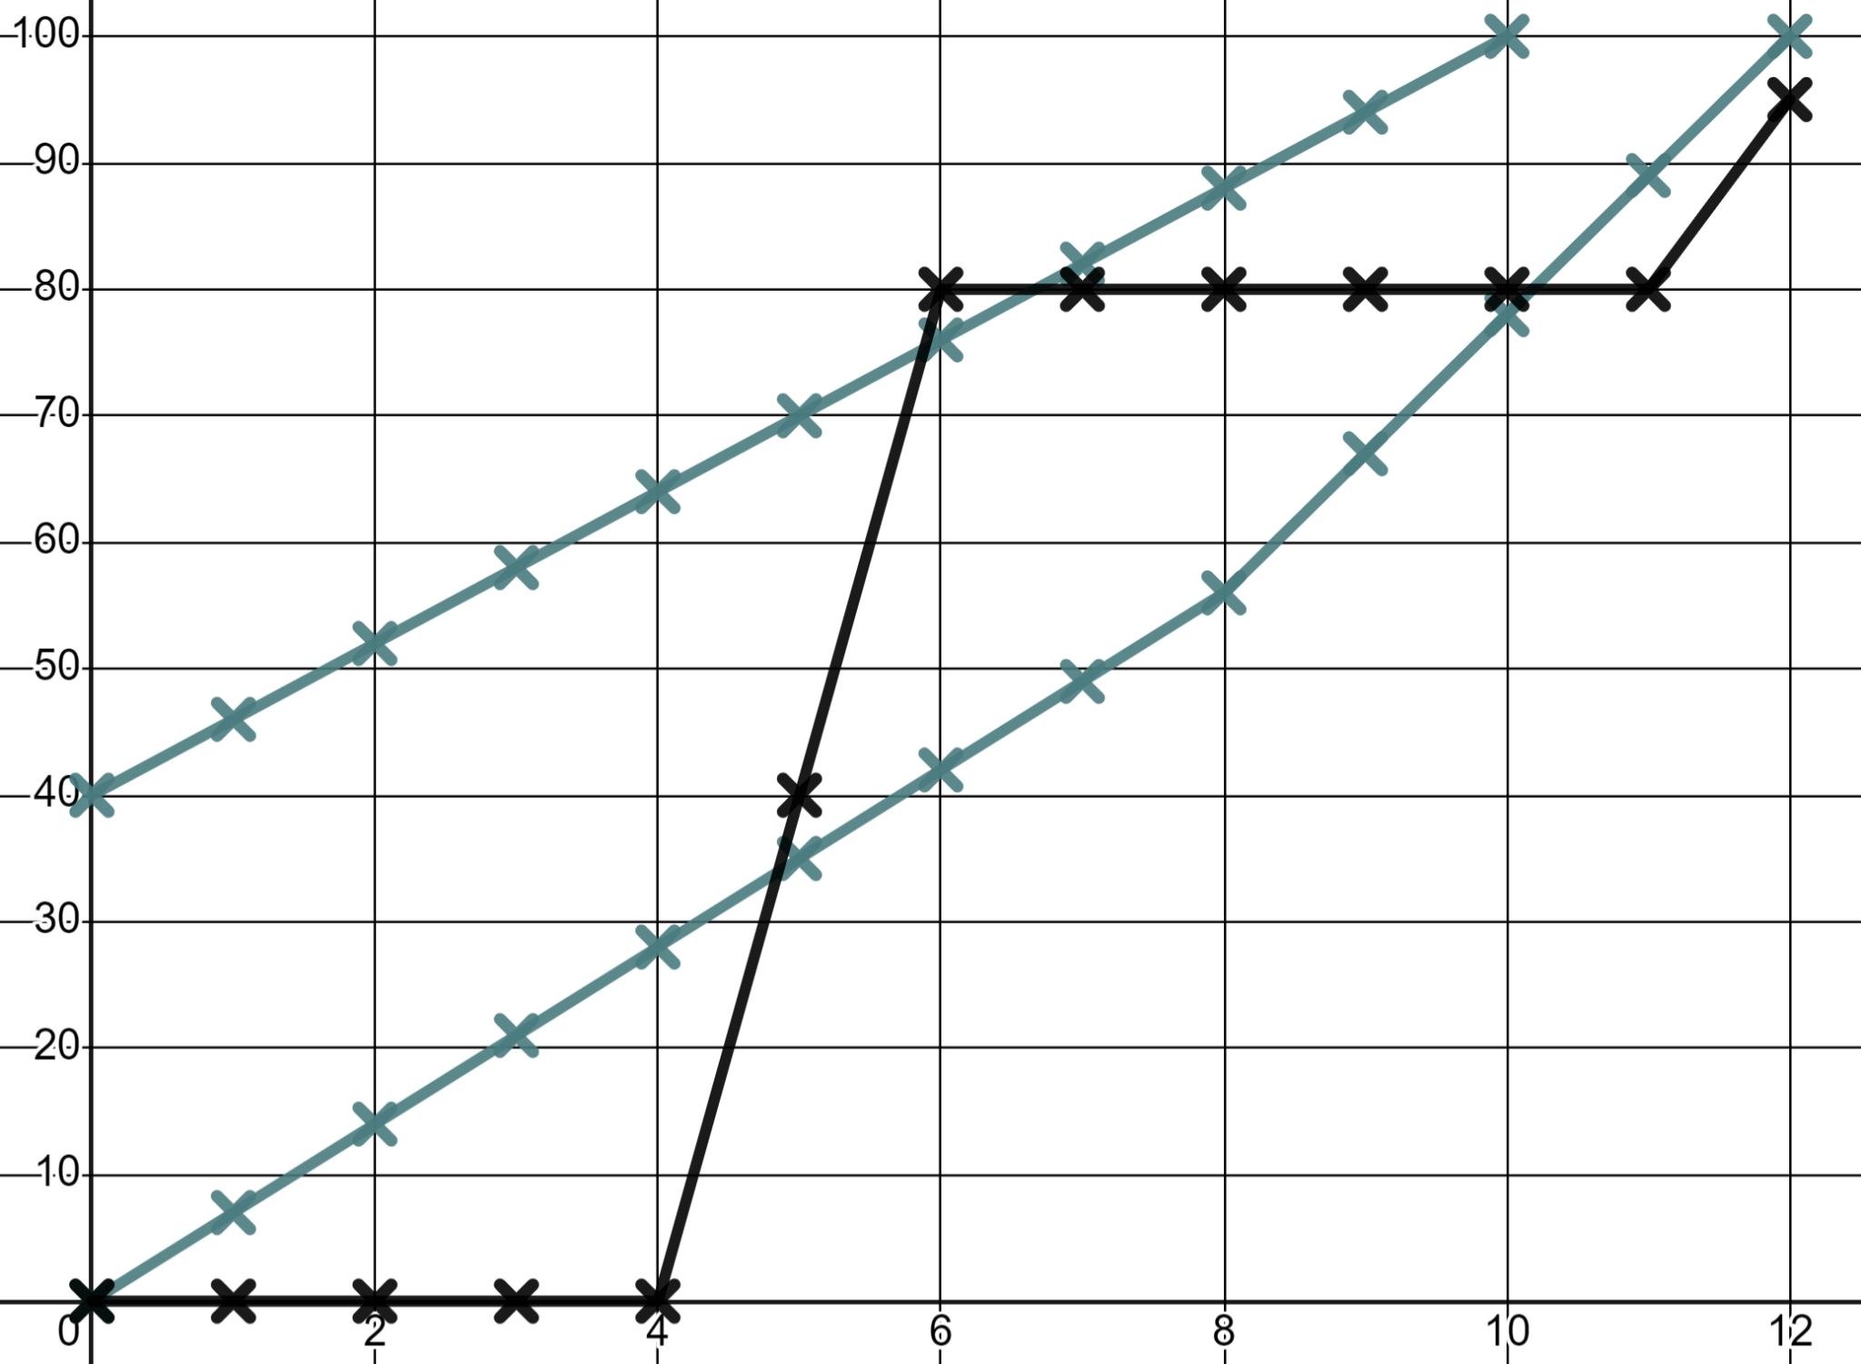
Problem solving with graphing linear relationships
Task B: Interpreting more complex linear graphs
1) Write a commentary to describe this race.
d
The distance units are metres. The time is in seconds.
Sofia
Keep your commentary in chronological (time) order.
Andeep
Laura
t
You might have written:
And they’re off! Andeep and Sofia start at a constant speed, Sofia with her 40 metre headstart. 2 seconds in and Sofia has passed the 50 metre mark but Laura hasn’t even started yet; what is she doing!
Finally, after 4 seconds Laura starts and wow, does she start! That is the fastest speed we’ve seen yet in this race! Within a second of her starting she overtakes Andeep, within 2 seconds she is passed Sofia. But then she stops! She must think the race is over!
8 seconds in, Sofia is still moving at the same, constant speed. She’s overtaken Laura who looks like she might be asleep but, Andeep speeds up slightly to try and catch Sofia; will it be enough!
It’s not! After 10 seconds Sofia hits the finish line for the gold medal. Andeep joins her 2 seconds later in silver position. Laura finally woke up and started running again but didn’t even even get to the finish line.
Mathematics in Education and Industry
v2.2

